Slide 1

Banking System using Linked List
BY : SHRIYANSH AGARWAL

Slide 2
CONTENT:
Introduction
Data Structure
Project Summary
Problem Analysis
Flow charts,Gantt Chart
Benifits of pursuing the course

Slide 3

Introduction
What are Data Structures?
The data structure is a storage that is used to store and organize data. It is a way of arranging data on a computer so that it can be accessed and updated efficiently. Depending on our requirement and project, it is important to choose the right data structure for our project. For example, if we want to store data sequentially in the memory, then we can go for the Array data structure.

Slide 4

WHAT IS DATA STRUCTURE??
DATA IN MEMORY.
SET OF ALGORITHMS.
ORGANIZING DATA.
SET OF RULES

Slide 5

The elements are arranged in sequence one after the other
Linear Data Structure
Easy to implement
Array, List, Stack, Queue

Slide 6

The elements are not in any sequence.
Non-Linear Data Structure
Arranged in a hierarchical manner
The element will be connected to one or more elements.

Slide 7

PROJECT SUMMARY
The idea behind the project is to develop a simple banking accounting system with the use of a linked-list data structure. There is a set of simple features that are Registering an account, withdrawing money, depositing money, getting out statements, fixed deposits, closing an account.

Slide 8

WHY LINKED LIST??
Linked lists offer some important advantages over other linear data structures. Unlike arrays, they are a dynamic data structure, resizable at run-time. Also, the insertion and deletion operations are efficient and easily implemented.

Slide 9

PROFILE OF THE PROBLEM
A banking system is a group or network of institutions that provide financial services for us. These institutions are responsible for operating a payment system, providing loans, taking deposits, and helping with investments. In today’s world, the banking system is a great part of smooth function of a state, of a country and the whole world. A small failure in the banking system may lead to a big failure as all.

Slide 10

PROBLEM ANALYSIS
Product Definition: This banking system involves maintaining account-related information. This requires greater accuracy, the speed which is why the proposed system is the computerization of the existing system.

Slide 11

FEASIBILITY ANALYSIS
The application certainly has the same striking advantage over the manual system. There will be no paperwork as possible, and the information will be updated as it changes with this system one can generate the statement of the account

Slide 12

PRIMARY ADVANTAGES
The main advantage of BAS is that it will become a powerful tool in the establishment of a better system in comparison to the existing system. It helps to protect the system from corruption. After installation of BAS in the bank, there is a greater possibility of stabilization a clear and fair system, which will be accurate, updated and fast. There is no doubt that there always remains some scope for improvement.
The important thing is that the system developed should be flexible to accommodate any future enhancements. This system can be used to provide some enhancement without rewriting of existing code.

Slide 13
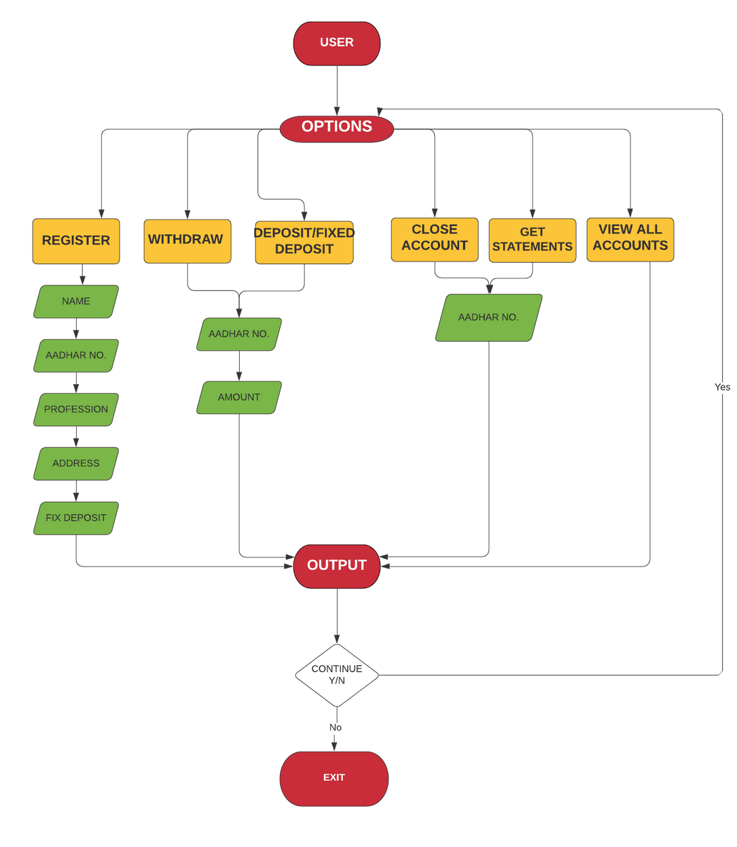
FLOW
CHART

Slide 14

BENEFITS OF PURSUING THIS COURSE

Slide 15



BENEFITS OF COURSE
DSA Concepts
Competetive Programming
Future Demand
Pursuing Data Science as an engineering minor, it is required for me to have a good knowledge of DSA concepts.
Made me clear with DSA Concepts in efficient way.
Made me familiar with Competitive Coding and its concepts.

Slide 16
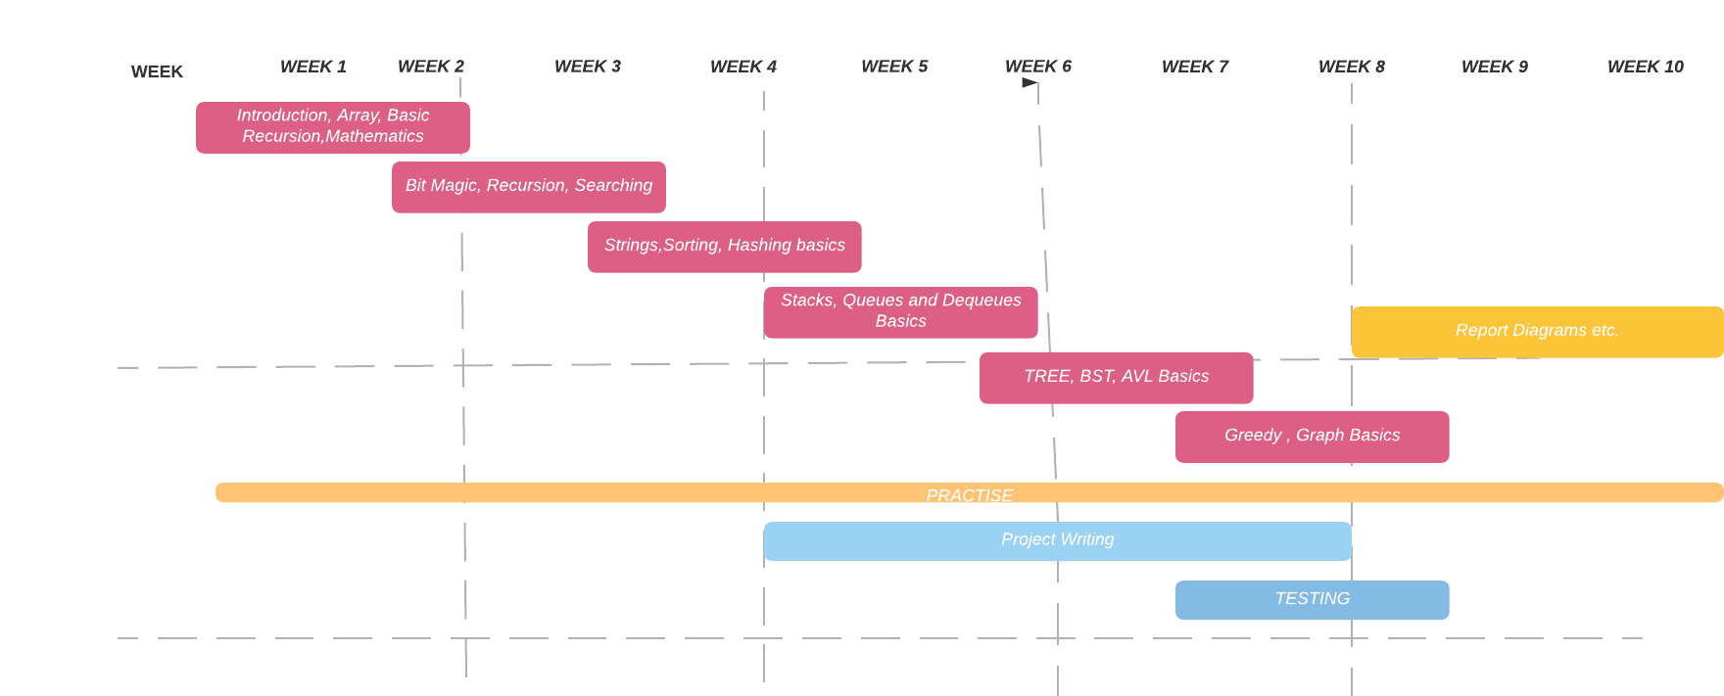
Gantt Chart

Slide 17


